Slide 1
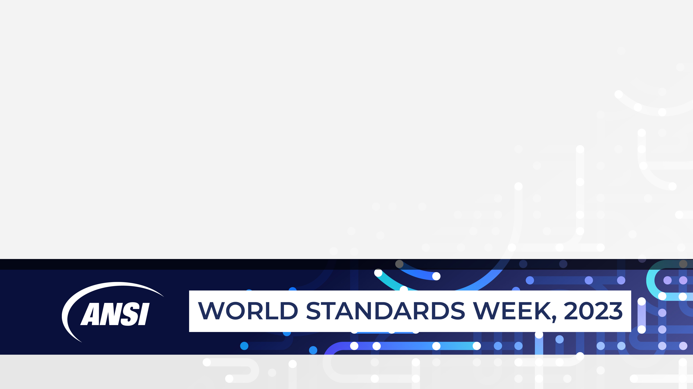
AI 101 – Understanding Generative AI and Large Language Models
10th October 2023
Rohit Israni, Founder & CEO, CertientAI and Chair, INCITS/Artificial Intelligence
rohit@certientai.com

Slide 2

AI Standards in Time Magazine !
Time AI 100
Elham Tabassi
Associate Director of Emerging Technologies, NIST
INCITS/Artificial Intelligence

Slide 3


Prompt: What is Generative AI?
As per ISO/IEC JTC 1 TR 42103, Overview of Synthetic Data in the Context of AI Systems (ISO/IEC JTC 1 SC 42 Project in Progress), Generative AI is defined as, “an AI system which produces synthetic data”
Artificial Intelligence
Machine Learning
Deep Learning
GenAI
* Sources: Beatles in DC, courtesy Canvas Generative AI application, archives

Slide 4
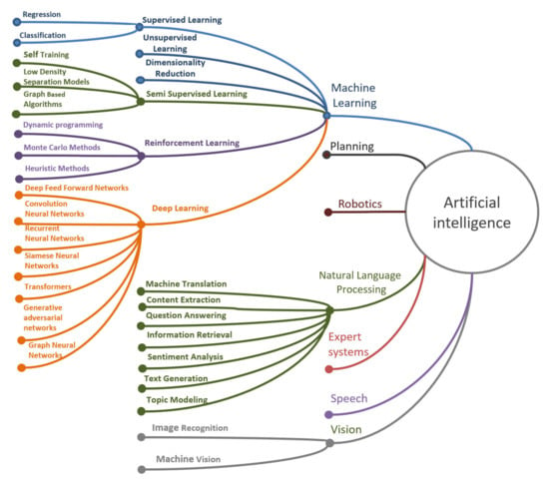
AI Defined
3.1.3
artificial intelligence
AI
<discipline> research and development of mechanisms and applications of AI systems (3.1.4)
Note 1 to entry: Research and development can take place across any number of fields such as computer science, data science, humanities, mathematics and natural sciences.
3.1.4
artificial intelligence system
AI system
engineered system that generates outputs such as content, forecasts, recommendations or decisions for a given set of human-defined objectives
Note 1 to entry: The engineered system can use various techniques and approaches related to artificial intelligence (3.1.3) to develop a model (3.1.23) to represent data, knowledge (3.1.21), processes, etc. which can be used to conduct tasks (3.1.35).
Note 2 to entry: AI systems are designed to operate with varying levels of automation (3.1.7).
Source: ISO/IEC 22989:2022(en), Information technology — Artificial intelligence — Artificial intelligence concepts and terminology
“Colloquially, the term ‘artificial intelligence’ is applied when a machine mimics ‘cognitive’ functions that humans associate with other human minds, such as ‘learning' and ‘problem solving’.” (Wikipedia)
Source: Review of Artificial Intelligence and Machine Learning Technologies: Classification, Restrictions, Opportunities and Challenges, Advances in Machine Learning and Applications. July 22, Mukhamediev et all

Slide 5
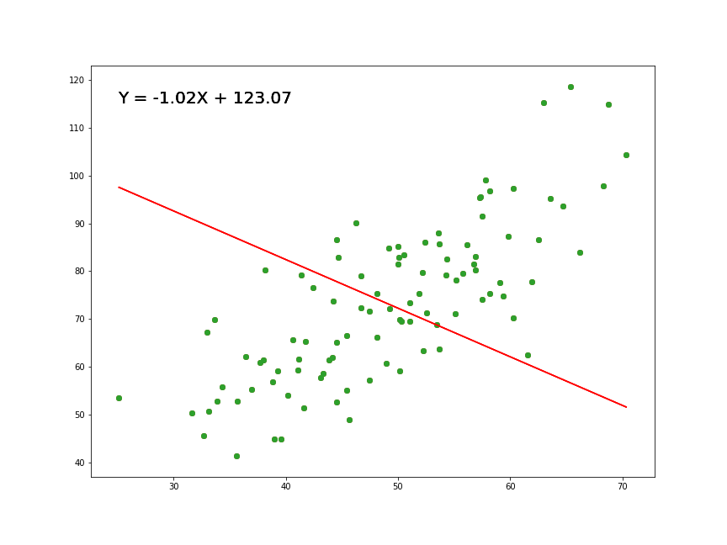
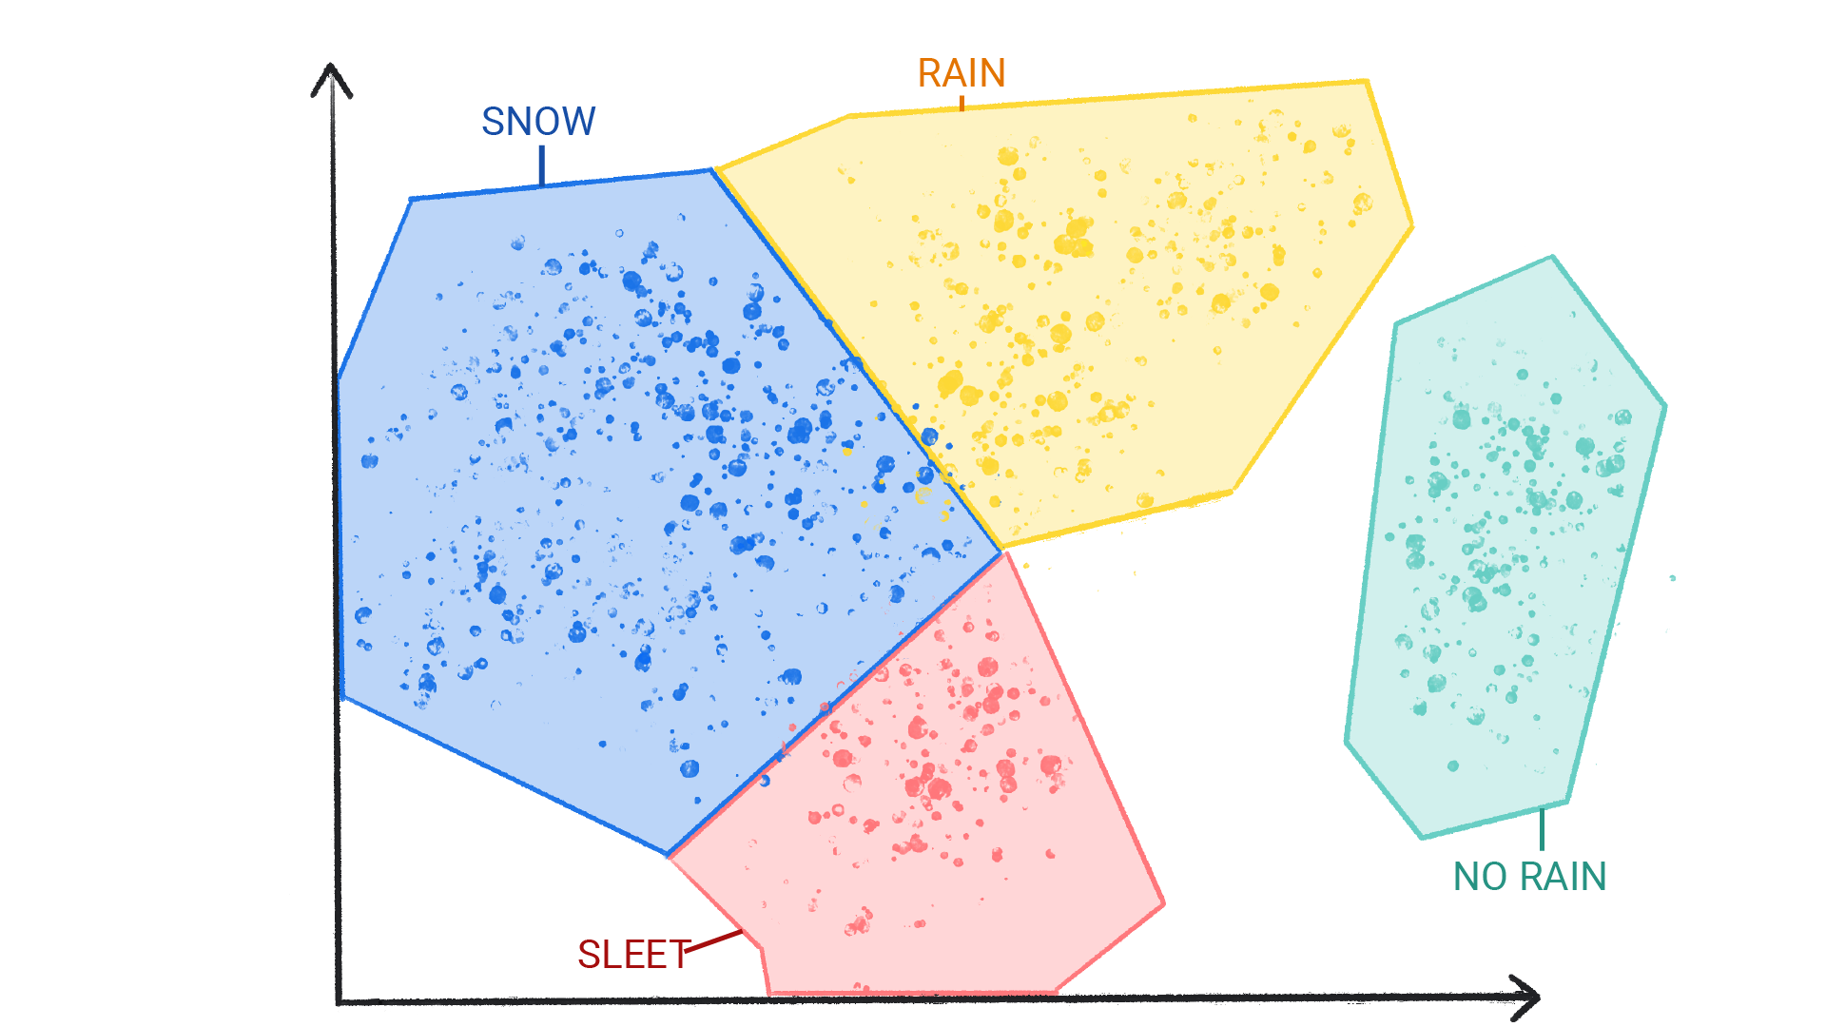
Machine Learning: Regression and Clustering
Source: Linear Regression Using Least Squares | by Adarsh Menon | Towards Data Science
Source: What is Machine Learning? | Google for Developers

Slide 6

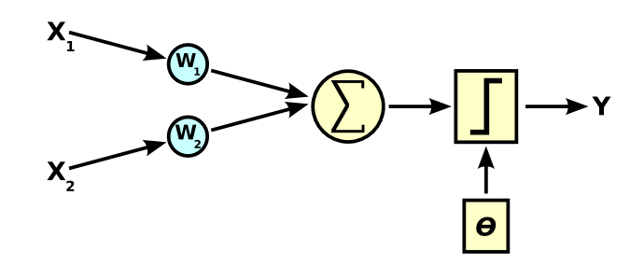
Neural Networks
Biological Neurons
AI Neuron
Y = Activation function(∑ (weights*input + bias)
Source: Wikipedia
Source: Live Neuronal Activity - courtesy of Michelle Kuykendal & Gareth Guvanasen
Secondary: a.i. art blog — Pindar Van Arman's cloudpainter

Slide 7
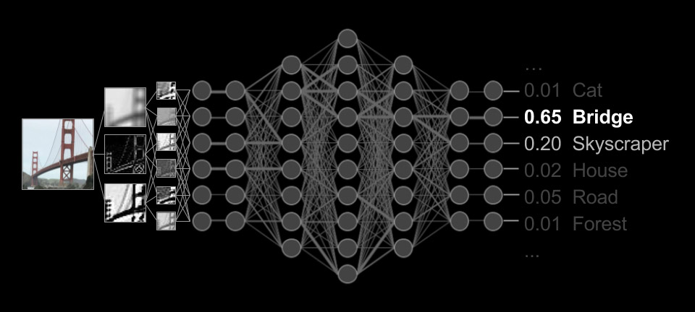
Deep Learning – Training and Inference
Source: a.i. art blog — Pindar Van Arman's cloudpainter

Slide 8
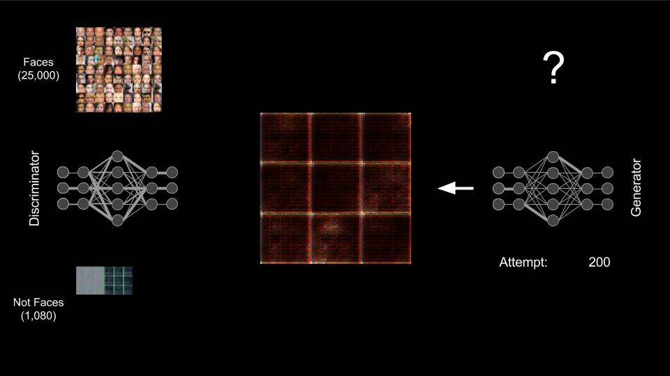

Generative AI - Images
Source: a.i. art blog — Pindar Van Arman's cloudpainter
Source: a.i. art blog — Pindar Van Arman's cloudpainter

Slide 9
Generative AI Language Models- Autocomplete
When I hear rain on my roof, I _______ in my kitchen
cook soup 9.4%
warm up a kettle 5.2%
nap 2.5%
relax 2.2%
jog…
A language model is a machine learning model that aims to predict and generate plausible language.
Words or characters are converted into numerical tokens.
Estimate the probability of a token or sequence of tokens occurring within a longer sequence of tokens.
Source: Introduction to Large Language Models | Machine Learning | Google for Developers

Slide 10
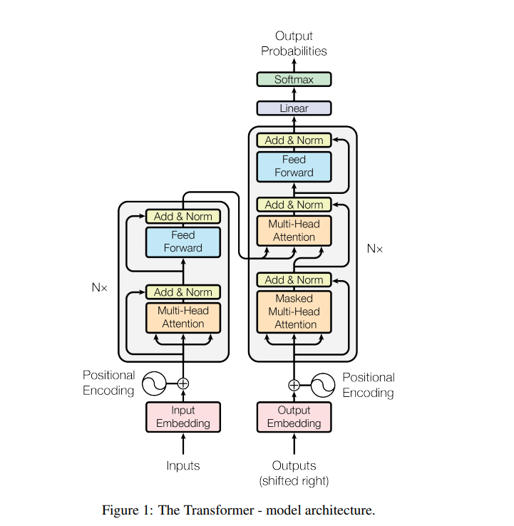
Generative AI LLMs- Attention is All You Need
Example - Original Text:
Original Text: "In a groundbreaking discovery, scientists have found a new exoplanet orbiting a distant star. This exoplanet, named 'Kepler-452b,' is located in the habitable zone of its star, meaning it could potentially support liquid water and, therefore, life. Kepler-452b is about 1.6 times the size of Earth and orbits a sun-like star called Kepler-452. This discovery raises exciting possibilities for the search for extraterrestrial life beyond our solar system.“
Summary:
Summary: "Scientists have discovered a new exoplanet, Kepler-452b, in the habitable zone of a sun-like star. It's 1.6 times the size of Earth and could potentially support life, sparking excitement in the search for extraterrestrial life."
Encoder-Decoder Architecture
Attention Mechanism
Source: [1706.03762] Attention Is All You Need (arxiv.org) Vaswani, Et al.
Source: ChatGPT- prompt: example requested for this presentation
Notes:
Original Text: "In a groundbreaking discovery, scientists have found a new exoplanet orbiting a distant star. This exoplanet, named 'Kepler-452b,' is located in the habitable zone of its star, meaning it could potentially support liquid water and, therefore, life. Kepler-452b is about 1.6 times the size of Earth and orbits a sun-like star called Kepler-452. This discovery raises exciting possibilities for the search for extraterrestrial life beyond our solar system."
Summary:
Summary: "Scientists have discovered a new exoplanet, Kepler-452b, in the habitable zone of a sun-like star. It's 1.6 times the size of Earth and could potentially support life, sparking excitement in the search for extraterrestrial life."
Explanation of Mechanics - Tokens, Attention, Encoder, and Decoder:
Tokens: Tokens are the basic units into which the text is divided. In the original text and summary, each word and punctuation mark is a token. For example, "Scientists" is one token, "discovered" is another, and so on.
Encoder-Decoder Architecture: Summarization often involves the use of an encoder-decoder architecture, much like the Transformer model. Here's how it works:
Encoder: The encoder takes the original text and converts it into a numerical representation. It processes each token in the text, one at a time, and encodes information about the tokens' relationships, positions, and meanings into a high-dimensional vector. This vector representation captures the essence of the text's content.
Attention Mechanism: Within the encoder, an attention mechanism is used to weigh the importance of different tokens in relation to each other. For instance, when the encoder processes the word "Kepler-452b," it pays more attention to the context and significance of this word in the text. This helps it understand that it's talking about an exoplanet.
Decoder: The decoder takes the encoded representation of the text and generates a summary. It processes the encoded information step by step, token by token, and generates the summary tokens one after another. The decoder uses attention mechanisms to focus on relevant parts of the encoded text while generating each token in the summary.
Abstractive Summarization: In this example, abstractive summarization is used because the summary is not a direct extraction of sentences from the original text but a concise, human-like version that conveys the main points. The model understands the context and generates new sentences, such as "It's 1.6 times the size of Earth and could potentially support life," which are not verbatim copies of sentences in the original text.
In summary, the encoder-decoder architecture, powered by mechanisms like attention, allows the model to read and understand the original text and then generate a coherent, abstractive summary that captures the essential information. It does this by encoding the text into a numerical representation, attending to important parts, and decoding that representation into a summary while considering context and relationships between tokens.

Slide 11
Challenges with GenerativeAI
Hallucinations
Copyright
Bias
Adversarial Attacks (Security)
Misinformation and Deepfakes
Data Privacy
Lack of Accountability
Environmental Impact
Workforce Displacement
Regulations and Governance

Slide 12
Prompt: Will Generative AI Rewrite the Future?
ChatGPT: 10/6/23, 8:55 PM (PST)
Generative AI has the potential to influence the future significantly, but its impact will depend on technological advancements, regulatory decisions, ethical considerations, and societal choices. While it won't single-handedly "rewrite" the future, it will play a substantial role in shaping it through innovation, economic changes, and addressing important ethical and social implications.

Slide 13
For More Information
A Beginner's Guide to Large Language Models (nvidia.com)
How LLMs are Unlocking New Opportunities for Enterprises (nvidia.com)
Prompt engineering overview | Microsoft Learn
Introduction to Large Language Models | Machine Learning | Google for Developers
Intel® AI Academy
[1706.03762] Attention Is All You Need (arxiv.org)
Stanford CS 25 | Transformers United
a.i. art blog — Pindar Van Arman's cloudpainter
Email: rohit@certientai.com

